Slide 1
LUDO GAME
Presented By:
Pragati Kumari

Slide 2
Ludo Game Ludo is a board game for two to four players, in which the players race their four tokens from start to finish according to dice rolls
Game Rules Each throw, the player decides which piece to move. A piece simply moves in a clockwise direction around the track given by the number thrown. If no piece can legally move according to the number thrown, play passes to the next player.
A throw of 6 gives another turn.
A player must throw a 6 to move a piece from the starting circle onto the first square on the track. The piece moves 6 squares around the circuit beginning with the appropriately coloured start square (and the player then has another turn).
If a piece lands on a piece of a different colour, the piece jumped upon is returned to its starting area. If a piece lands upon a piece of the same colour, this forms a block. This block cannot be passed or landed on by any opposing piece.
Winning
When a piece has circumnavigated the board, it proceeds up the home column. A piece can only be moved onto the home area by an exact throw.

Slide 3
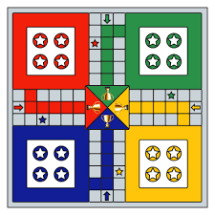
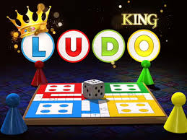

Slide 4
International) in Gaming at the 19th FICCI Frames Best Animated Frames (BAF) Awards.
Ludo King was selected as Best Casual Game of 2018 on Google Play Store
Ludo King won the Mobile & Tablet Game: Arcade/Casual (by popular vote.
According to the Google's annual Year in Search: Insights for Brands report, Ludo King was in the Top 3 downloaded games in India in 2018.[Ludo King was named "No.1 Game of India" by MidDay.
Gametion Technologies earned the ET Startup Award 2020, with recognition as the Bootstrap Champ of 2020.[Apple App Store listed Ludo King in the list of 21 apps for 2021 [Gametion Technologies ranked Number 1 in the category of "Top 10 India Headquartered Games Publishers" in the Top Published Awards 2021 by App Annie.[According to App Annie, Ludo King was Number 1 in its list of Most downloaded mobile games in India in 2020.[]
Ludo King was the second most-trusted media brand among Indian kids with a Brand Trust Score of 65%, according to a survey done by Ormax Media.[According to AppAnnie, Gametion was the number one Indian game publisher in terms of downloads.[As of April 2021, Ludo King ranks among the Top 10 games downloaded on Google Play Store

Slide 5
Each player rolls a die; the highest roller begins the game. Players alternate turns in a clockwise direction. To enter a token into play from its yard to its starting square, a player must roll a six. Players can draw a token from home every time they get a six unless home is empty or move a piece six times. The start box has two own tokens (is doubled). If the player has no tokens yet in play and rolls other than a six, the turn passes to the next player.
Players must always move a token according to the die value rolled. Once players have one or more tokens in play, they select a token and move it forwards along the track the number of squares indicated by the die. If an opponent's token is blocking the pathway, the player must land on the same space as the token to capture it. Players cannot move past that token. Passes are not allowed; if no move is possible, the turn moves to the next player.
If the player cannot draw a token from home, rolling a six earns the player an additional or "bonus" roll in that turn. If the bonus roll results in a six again, the player earns again an additional bonus roll.^{I}f the third roll is also a six, the player may not move and the turn immediately passes to the next player.
If the advance of a token ends on a square occupied by an opponent's token, the opponent token is returned to its owner's yard. The returned token can be re-entered into play only when the owner rolls a six. If a piece lands on the same space as another piece of the same colour, the pieces are doubled and form a "block".^{[6]} If the advance of a block ends on an opponent’s block, the latter is captured and returned to its owner’s yard, collectively.
A player's home column squares are always safe, since no opponent may enter them. In the home column, a player cannot jump over; after one rotation is completed, the player must enter the home and roll the exact number needed to get each token onto the home tr

Slide 6
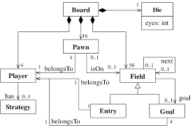

LUDO GAME
Ludo
Ludo Game

Slide 7


